Slide 1
CS326 Parallel and Distributed Computing
Spring 2021
National University of Computer and Emerging Sciences

Slide 2
Chapter 6. Programming Using the Message Passing Paradigm

Slide 3
Recall…
A message-passing platform consists of p processing nodes, each with its own exclusive address space.
Interactions between processes running on different nodes must be accomplished using messages (data, work, and to synchronize actions among the processes), hence the name message passing.
The basic operations in this programming paradigm are send and receive.
The message-passing programming paradigm is one of the oldest and most widely used approaches for programming parallel computers.

Slide 4
Principles of Message-Passing Programming
The two key attributes to characterize the message-passing programming paradigm.
The first is that it assumes a partitioned address space
Second is that it supports only explicit parallelization.
There are two immediate implications of a partitioned address space.
First, each data element must belong to one of the partitions of the space; hence, data must be explicitly partitioned and placed.
The second implication is that all interactions (read-only or read/write) require cooperation of two processes - the process that has the data and the process that wants to access the data

Slide 5
Principles of Message-Passing Programming
Message-passing programs are often written using the asynchronous or loosely synchronous paradigms
In the asynchronous paradigm, all concurrent tasks execute asynchronously.
However, such programs can be harder to reason about, and can have nondeterministic behavior due to race conditions .
In the loosely synchronous model, tasks or subsets of tasks synchronize to perform interactions. Between these interactions, tasks execute completely asynchronously.
Most message-passing programs are written using the single program multiple data (SPMD) model.
Notes:
The message-passing programming paradigm requires that the parallelism is coded explicitly by the programmer.
In its most general form, the message-passing paradigm supports execution of a different program on each of the p processes. This provides the ultimate flexibility in parallel programming, but makes the job of writing parallel programs effectively unscalable.
In SPMD programs the code executed by different processes is identical except for a small number of processes (e.g., the "root" process)

Slide 6
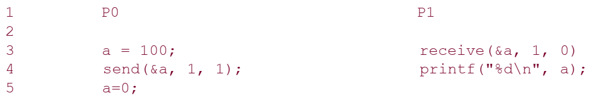
The Building Blocks: Send and Receive Operations
In their simplest form, the prototypes of these operations are defined as follows:
send(void *sendbuf, int nelems, int dest)
receive(void *recvbuf, int nelems, int source)
Notes:
The semantics of the send operation require that the value received by process P1 must be 100 as opposed to 0.
This motivates the design of the send and receive protocols.

Slide 7
The semantics of the send operation require that the value received by process P1 must be 100 as opposed to 0.
This motivates the design of the send and receive protocols.

Slide 8
Blocking Message Passing Operations
A simple method for forcing send/receive semantics is for the send operation to return only when it is safe to do so.
In the non-buffered blocking send, the operation does not return until the matching receive has been encountered at the receiving process.
Idling and deadlocks are major issues with non-buffered blocking sends.

Slide 9
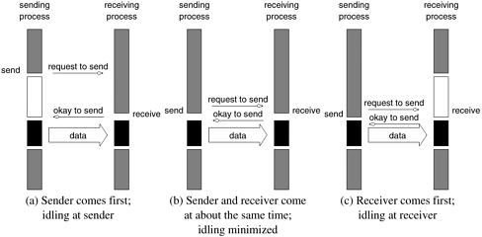
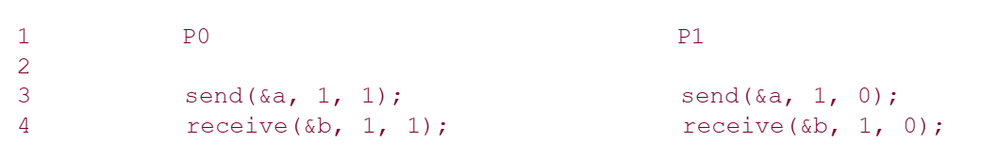

Slide 10
In buffered blocking sends, the sender simply copies the data into the designated buffer and returns after the copy operation has been completed.
The data is copied at a buffer at the receiving end as well.
Buffering alleviates idling at the expense of copying overheads.

Slide 11
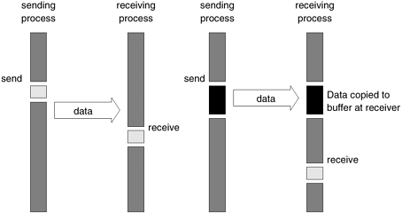
Blocking buffered transfer protocols: (a) in the presence of communication hardware with buffers at send and receive ends; and (b) in the absence of communication hardware, sender interrupts receiver and deposits data in buffer at receiver end.

Slide 12
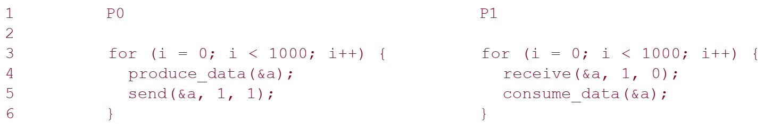
What if consumer was much slower than producer?
This can often lead to unforeseen overheads and performance degradation.

Slide 13
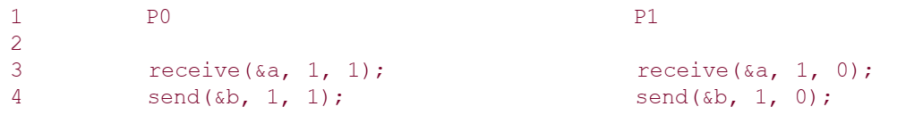
Deadlocks are still possible with buffering since receive operations block.

Slide 14
Non-Blocking Message Passing Operations
This class of non-blocking protocols returns from the send or receive operation before it is semantically safe to do so.
Non-blocking operations are generally accompanied by a check-status operation.
When used correctly, these primitives are capable of overlapping communication overheads with useful computations.
Message passing libraries typically provide both blocking and non-blocking primitives.

Slide 15
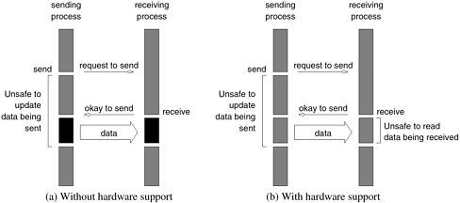

Slide 16
MPI: the Message Passing Interface
To be covered in Future…

Slide 17
Chapter 7. Programming Shared Address Space Platforms

Slide 18
Explicit parallel programming requires specification of parallel tasks along with their interactions.
These interactions may be in the form of synchronization between concurrent tasks or communication of intermediate results.
In shared address space architectures, communication is implicitly specified since some (or all) of the memory is accessible to all the processors

Slide 19
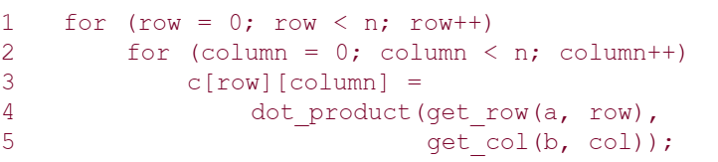
Thread Basics
A thread is a single stream of control in the flow of a program. A program like:
The for loop in this code fragment has n² iterations, each of which can be executed independently. Such an independent sequence of instructions is referred to as a thread

Slide 20
There are n² threads, one for each iteration of the for-loop.
Since each of these threads can be executed independently of theothers, they can be scheduled concurrently on multiple processors.
for (row = 0; row < n; row++)
for (column = 0; column < n; column++)
c[row][column] = create_thread(dot_product(get_row(a, row), get_col(b, col)));
In this case, one may think of the thread as an instance of a function that returns before the function has finished executing.
To execute the above code fragment on multiple processors, each processor must have access to matrices a, b, and c.

Slide 21
All memory in the logical machine model of a thread is globally accessible to every thread.
Since threads are invoked as function calls, the stack corresponding to the function call is generally treated as being local to the thread.
This is due to the liveness considerations of the stack.
This implies a logical machine model with both global memory (default) and local memory (stacks).

Slide 22
Why Threads?
Threads provide software portability.
Inherent support for latency hiding.
Scheduling and load balancing.
Ease of programming and widespread use.

Slide 23
The POSIX Thread API
Commonly referred to as Pthreads, POSIX has emerged as the standard threads API, supported by most vendors.
The concepts discussed here are largely independent of the API and can be used for programming with other thread APIs (NT threads, Solaris threads, Java threads, etc.) as well.

Slide 24
Thread Basics: Creation and Termination
#include <pthread.h>
// A normal C function that is executed as a thread
// when its name is specified in pthread_create()
void *myThreadFun(void *vargp)
{
sleep(1);
printf("Printing GeeksQuiz from Thread \n");
return NULL;
}
int main()
{
pthread_t thread_id;
printf("Before Thread\n");
pthread_create(&thread_id, NULL, myThreadFun, NULL);
pthread_join(thread_id, NULL);
printf("After Thread\n");
exit(0);
}

Slide 25
In main() we declare a variable called thread_id, which is of type pthread_t, which is an integer used to identify the thread in the system.
After declaring thread_id, we call pthread_create() function to create a thread. pthread_create() takes 4 arguments
The first argument is a pointer to thread_id which is set by this function.
The second argument specifies attributes. If the value is NULL, then default attributes shall be used.
The third argument is name of function to be executed for the thread to be created.
The fourth argument is used to pass arguments to the function, myThreadFun

Slide 26
A call to pthread_join waits for the termination of the thread whose id is given by thread_id.
On a successful call to pthread_join, the value passed to pthread_exit is returned in the location pointed to by the second argument.
On successful completion, pthread_join returns 0, else it returns an error-code.

Slide 27
Thread Creation and Termination (Example)
#include <pthread.h>
#include <stdlib.h>
#define MAX_THREADS 512
void *compute_pi (void *);
....
main() {
...
pthread_t p_threads[MAX_THREADS];
pthread_attr_t attr;
pthread_attr_init (&attr);
for (i=0; i< num_threads; i++) {
hits[i] = i;
pthread_create(&p_threads[i], &attr, compute_pi,
(void *) &hits[i]);
}
for (i=0; i< num_threads; i++) {
pthread_join(p_threads[i], NULL);
total_hits += hits[i];
}
...
}

Slide 28
Thread Creation and Termination (Example)
void *compute_pi (void *s) {
int seed, i, *hit_pointer;
double rand_no_x, rand_no_y;
int local_hits;
hit_pointer = (int *) s;
seed = *hit_pointer;
local_hits = 0;
for (i = 0; i < sample_points_per_thread; i++) {
rand_no_x =(double)(rand_r(&seed))/(double)((2<<14)-1);
rand_no_y =(double)(rand_r(&seed))/(double)((2<<14)-1);
if (((rand_no_x - 0.5) * (rand_no_x - 0.5) +
(rand_no_y - 0.5) * (rand_no_y - 0.5)) < 0.25)
local_hits ++;
seed *= i;
}
*hit_pointer = local_hits;
pthread_exit(0);
}

Slide 29
Synchronization Primitives in Pthreads
When multiple threads attempt to manipulate the same data item, the results can often be incoherent if proper care is not taken to synchronize them.
Consider:
/* each thread tries to update variable best_cost as follows */
if (my_cost < best_cost)
best_cost = my_cost;
Assume that there are two threads, the initial value of best_cost is 100, and the values of my_cost are 50 and 75 at threads t1 and t2.
Depending on the schedule of the threads, the value of best_cost could be 50 or 75!
The value 75 does not correspond to any serialization of the threads.

Slide 30
Mutual Exclusion
The code in the previous example corresponds to a critical segment; i.e., a segment that must be executed by only one thread at any time.
Critical segments in Pthreads are implemented using Mutex locks (mutual exclusion locks)
Mutex-locks have two states: locked and unlocked. At any point of time, only one thread can lock a mutex lock. A lock is an atomic operation.
A thread entering a critical segment first tries to get a lock. It goes ahead when the lock is granted.
If the mutex-lock is already locked, the process trying to acquire the lock is blocked.
This is because a locked mutex-lock implies that there is another thread currently in the critical section and that no other thread must be allowed in.
Notes:
Polling

Slide 31
Mutual Exclusion
The Pthreads API provides the following functions for handling mutex-locks:
int pthread_mutex_lock(pthread_mutex_t *mutex_lock);
On leaving a critical section, a thread must unlock the mutex-lock associated with the section. If it does not do so, no other thread will be able to enter this section. Typically deadlock.
int pthread_mutex_unlock(pthread_mutex_t *mutex_lock);
On calling this function, in the case of a normal mutex-lock, the lock is relinquished and one of the blocked threads is scheduled to enter the critical section.

Slide 32
Mutual Exclusion
If a programmer attempts a pthread_mutex_unlock on a previously unlocked mutex or one that is locked by another thread, the effect is undefined.
OVERHEADS OF LOCKING
Locks represent serialization points since critical sections must be executed by threads one after the other.
Encapsulating large segments of the program within locks can, therefore, lead to significant performance degradation.
It is important to minimize the size of critical sections.

Slide 33
Alleviating Locking Overheads
It is often possible to reduce the idling overhead associated with locks using an alternate function, pthread_mutex_trylock.
This function attempts a lock on mutex_lock. If the lock is successful, the function returns a zero. If it is already locked by another thread, instead of blocking the thread execution it returns a value EBUSY.
This allows the thread to do other work and to poll the mutex for a lock.

Slide 34
While the function pthread_mutex_trylock alleviates this overhead, it introduces the overhead of polling for availability of locks.
threads would have to periodically poll for availability of lock.
A natural solution to this problem is an interrupt driven mechanism as opposed to a polled mechanism.
The availability of space is signaled by the consumer thread that consumes the task.
The functionality to accomplish this is provided by a condition variable.
A condition variable is a data object used for synchronizing threads. This variable allows a thread to block itself until specified data reaches a predefined state.

Slide 36
Controlling Thread and Synchronization Attributes

